Slide 1

Minimum Spanning Tree

Slide 2

TREE
A
Connected acyclic graph
Tree with n nodes contains exactly n-1 edges.
B
C
D
E
F
GRAPH
Graph with n nodes contains less than or equal to n(n-1)/2 edges.

Slide 3
SPANNING TREE...
Suppose you have a connected undirected graph
Connected: every node is reachable from every other node
Undirected: edges do not have an associated direction
...then a spanning tree of the graph is a connected subgraph in which there are no cycles
A connected, undirected graph
Four of the spanning trees of the graph

Slide 4
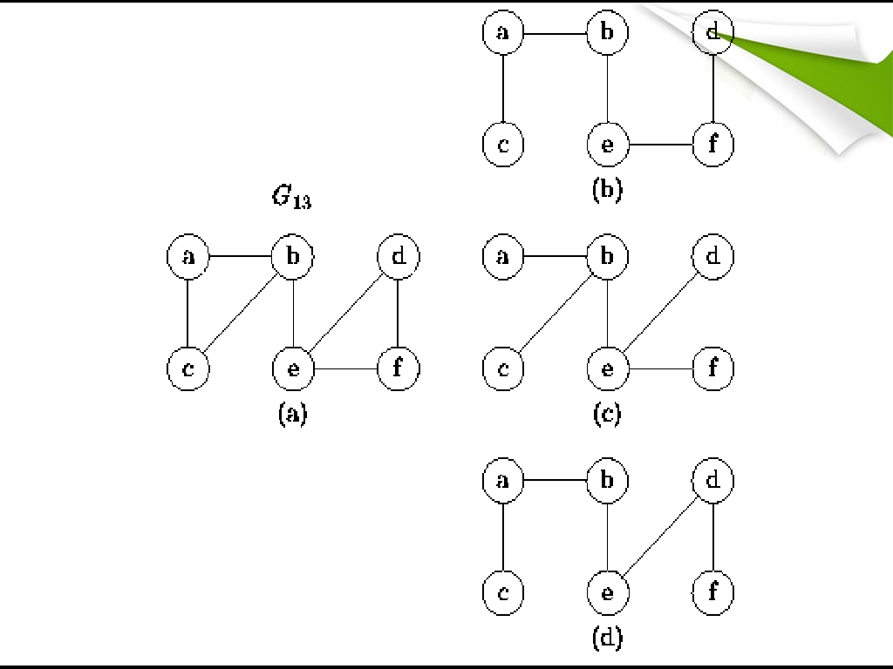

EXAMPLE..

Slide 5
Minimizing costs
Suppose you want to supply a set of houses (say, in a new subdivision) with:
electric power
water
sewage lines
telephone lines
✓To keep costs down, you could connect these houses with a spanning tree (of, for example, power lines)
✓However, the houses are not all equal distances apart
✓To reduce costs even further, you could connect the houses with a minimum-cost spanning tree

Slide 6
Example
A cable company want to connect five villages to their network which currently extends to the market town of Avonford.
What is the minimum length of cable needed?
Brinleigh
5
Cornwell
3
4
8
6
8
Avonford
Fingley
Donster
7
5
4
2
Edan

Slide 7
MINIMUM SPANNING TREE
Let G = (N, A) be a connected, undirected graph where N is the set of nodes and A is the set of edges. Each edge has a given nonnegative length. The problem is to find a subset T of the edges of G such that all the nodes remain connected when only the edges in T are used, and the sum of the lengths of the edges in T is as small as possible possible. Since G is connected, at least one solution must exist.

Slide 8
Finding Spanning Trees
There are two basic algorithms for finding minimum-cost spanning trees, and both are greedy algorithms
Kruskal’s algorithm:
Created in 1957 by Joseph Kruskal
Prim’s algorithm
Created by Robert C. Prim

Slide 9
We model the situation as a network, then the problem is to find the minimum connector for the network
B
5
C
3
4
8
6
8
A
F
D
7
5
4
2
E

Slide 10
Kruskal’s Algorithm
List the edges in order of size:
ED 2
AB 3
AE 4
CD 4
BC 5
EF 5
CF 6
AF 7
BF 8
CF 8
B
5
C
3
4
8
6
8
A
D
7
F
5
4
2
E

Slide 11
Kruskal’s Algorithm
B
5
C
Select the shortest edge in the network
ED 2
3
4
8
6
8
A
D
7
F
5
4
2
E

Slide 12
Kruskal’s Algorithm
B
5
C
Select the next shortest
edge which does not create a cycle
3
4
8
6
8
ED 2
AB 3
A
D
7
F
5
4
2
E

Slide 13
Kruskal’s Algorithm
B
5
C
Select the next shortest
edge which does not create a cycle
3
4
8
6
8
ED 2
AB 3
CD 4 (or AE 4)
A
D
7
F
5
4
2
E

Slide 14
Kruskal’s Algorithm
B
5
C
Select the next shortest edge which does not create a cycle
E
3
4
8
6
8
A
D
7
F
5
A
4
2
E
C

Slide 15
Kruskal’s Algorithm
B
5
C
Select the next shortest edge which does not create a cycle
3
4
8
6
ED 2
AB 3
D CD 4
AE 4
BC 5 – forms a cycle EF 5
8
A
7
F
5
4
2
E

Slide 16
Kruskal’s Algorithm
B
5
All vertices have been connected.
C
3
The solution is
4
8
6
ED 2
AB 3
CD 4
AE 4
EF 5
8
A
D
7
F
5
4
2
Total weight of tree: 18
E

Slide 17
Algorithm
function Kruskal (G=(N,A): graph ; length : A→R⁺):set of edges
{initialisation}
sort A by increasing length
N ← the number of nodes in N
T ← Ø {will contain the edges of the minimum spanning tree} initialise n sets, each containing the different element of N
{greedy loop} repeat
e ← {u , v} ← shortest edge not yet considered ucomp ← find(u)
vcomp ← find(v)
if ucomp ≠ vcomp then
merge(ucomp , vcomp) T ← T Ú {e}
until T contains n-1 edges return T

Slide 18
Kruskal’s Algorithm: complexity
Sorting loop:
Initialization of components: Finding and merging:
O(a log n) O(n)
O(a log n)
O(a log n)

Slide 19
Prim’s Algorithm
B
5
C
Select any vertex
3
A
Select the shortest edge connected to that vertex
AB 3
4
8
6
8
A
D
7
F
5
4
2
E

Slide 20
Prim’s Algorithm
B
5
C
Select the shortest edge connected to any vertex already connected.
AE 4
3
4
8
6
8
A
D
7
F
5
4
2
E

Slide 21
Prim’s Algorithm
B
5
C
3
Select the shortest edge connected to any vertex already connected.
ED 2
4
8
6
8
A
D
7
F
5
4
2
E

Slide 22
Prim’s Algorithm
B
5
C
Select the shortest edge connected to any vertex already connected.
DC 4
3
4
8
6
8
A
D
7
F
5
4
2
E

Slide 23
Prim’s Algorithm
B
5
C
Select the shortest edge connected to any vertex already connected.
3
4
8
6
8
A
EF 5
F
D
7
5
4
2
E

Slide 24
Prim’s Algorithm
B
5
All vertices have been connected.
C
3
The solution is
AB 3
AE 4
ED 2
DC 4
EF 5
4
8
6
8
A
D
7
F
5
4
2
Total weight of tree: 18
E

Slide 25
Prim’s Algorithm
function Prim(G = <N,A>: graph ; length : A →R⁺) : set of edges
{initialisation} T ← Ø
B ← {an arbitrary member of N}
While B ≠ N do
find e = {u , v} of minimum length such u € B and v € N \ B
T ←T υ {e} B ← B υ {v}
Return T
Complexity:
Outer loop: n-1 times Inner loop: n times O(n²)

Slide 26
Example
8
7
b
c
d
9
4
2
a
11
i
14
e
10
4
7
6
8
h
g
f
1
2

Slide 27
Solution
8
7
b
c
d
9
4
2
a
11
i
14
e
10
4
7
6
8
h
g
f
1
2

Slide 28
Minimum Connector Algorithms
Kruskal’s algorithm
Select the shortest edge in a network
Select the next shortest edge which does not create a cycle
Repeat step 2 until all vertices have been connected
Prim’s algorithm
Select any vertex
Select the shortest edge connected to that vertex
Select the shortest edge connected to any vertex already connected
Repeat step 3 until all vertices have been connected

Slide 29





Thank you!!

Slide 30



